Slide 1

Integrating Blockchain Implemented Crowdfunding as a Feature to Social Media
Guided by,
G.S Ajith
Submitted by,
Justin v kalappura

Slide 2
CONTENTS:
1. Introduction
2. Literature Review
3. Methodology
4. Results and Discussion
5. Conclusion

Slide 3
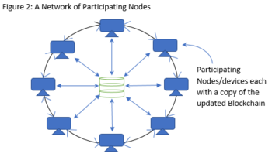
1.INTRODUCTION:
1. What is Crowdfunding?
– a type of online fundraising
2. What is Blockchain?
– a system of nodes with common ledger in a peer to peer network

Slide 4
3. Y crowdfunding feature to social media?
- To get easy access or more usability
4. Problem with Existing System?
a. Not having equal opportunity for every user to get funded equally
b. Current financial status is not Transparent
c. Not supportive for normal people
5. Advantages of Proposed system?
1. Equal opportunity for getting funded
2. Transparent financial status
3. Even supportive for normal people.

Slide 5
2. Literature Review:
1. One study by Böhme et al.
- highlights the potential of blockchain-based crowdfunding platforms to reduce information transperancy between contributors and receivers.
2. Another study by Alsmadi et al.
- proposes a blockchain-based crowdfunding platform will be a system that utilizes a decentralized application (DApp) to make sure the transparency and immutability in the fundraising process.
3. A study by Tran et al.
- proposes a blockchain-based crowdfunding platform that leverages an escrow mechanism to minimize the risk of fraud.
4. According to the analysis conducted by Zhu and Zhou,
- blockchain remains an emerging technology that is currently at the exploratory stage.

Slide 6
3.METHODOLOGY:
Basic Things to know?
* Identify the network to deploy? Ethreum
* Coin needed to make transaction in Ethreum? ETH
* Test network To try? Goerli testnetwork
* Coin needed to make transaction in Ethreum? GoerliETH
Things to do?
* Make a Wallet account? Metamask (Gateway to Web3)
* Make account and collect corresponding coins for that particular network?
* Network Faucet? To get free coins for developers (Goerli faucet)
* World Dapp Store? DappRadar

Slide 7
Steps to implement?
Step 1: Smart contract creation.
Step 2: Bytecode deployment to the Goerli testnetwork of Ethreum blockchain.
Step 3: Integrate crowdfunding as a feature to the Social media as a separate module.
Things a user can do?
1. System user: (Socialmedia User and Ethereum Network user)
2. Project creation:
3. Contribute to project:

Slide 8
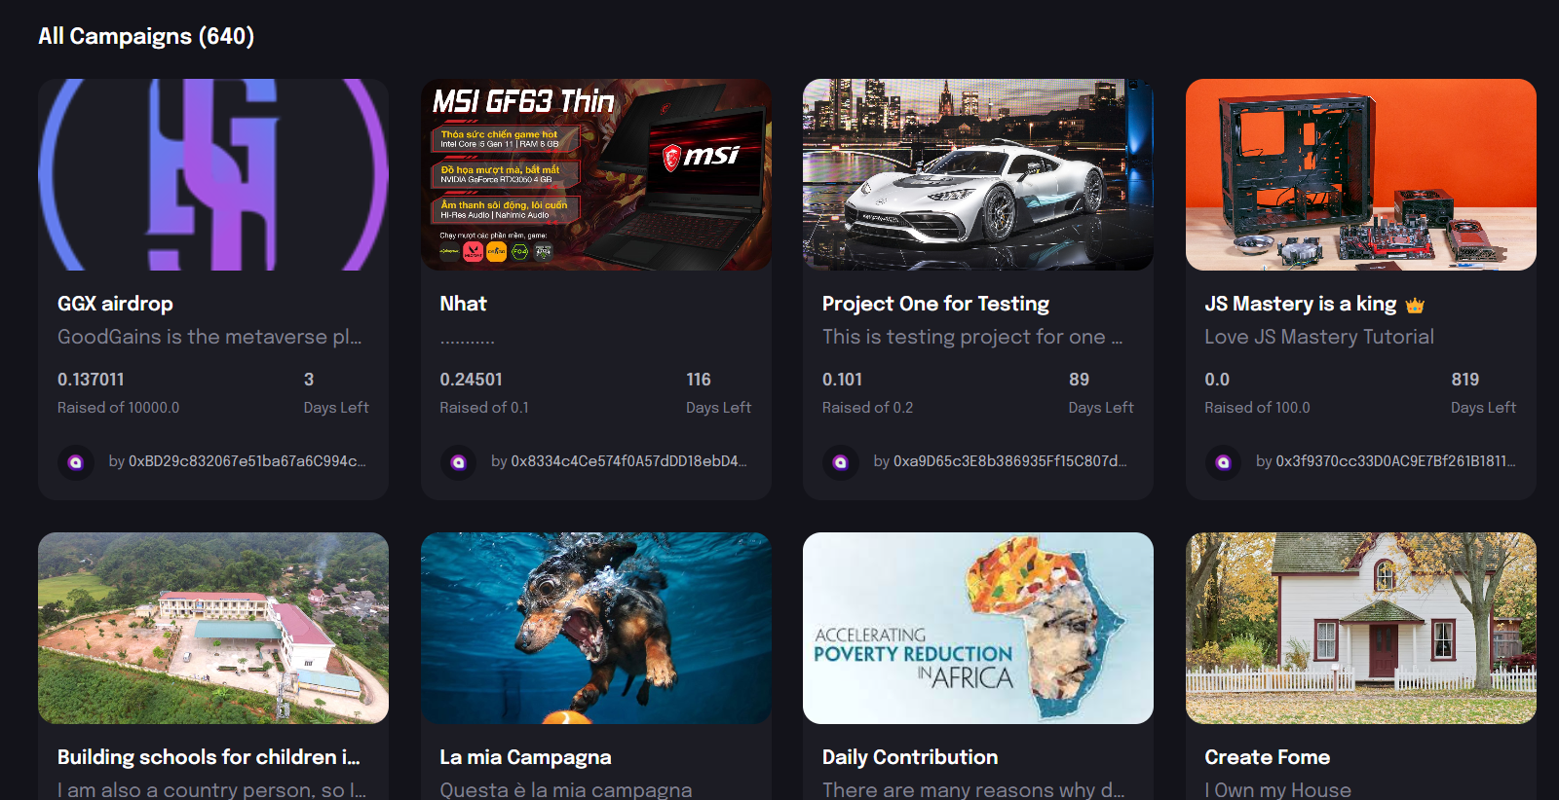
4.RESULT AND DISCUSSION:
.
(i) List of campaigns

Slide 9
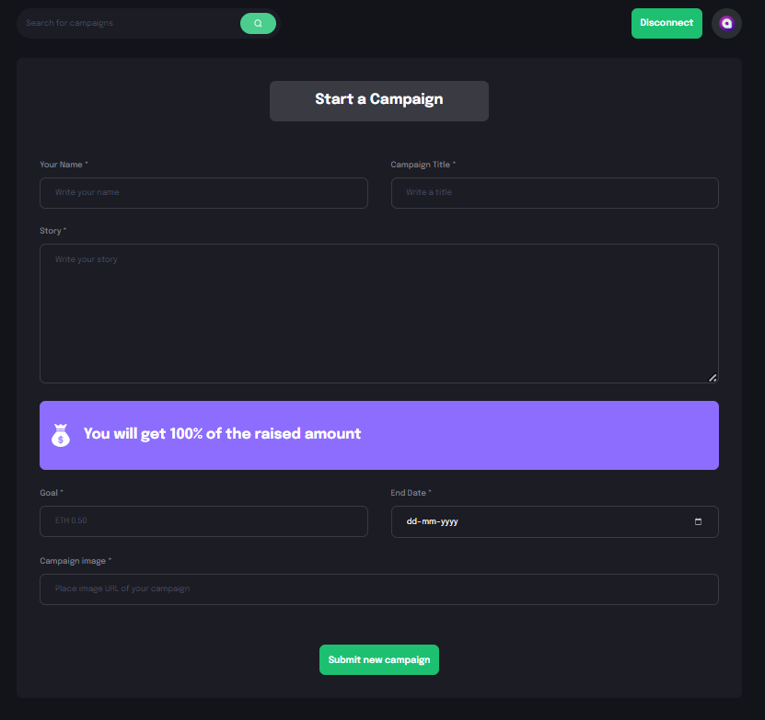
(ii) Create Campaign

Slide 10
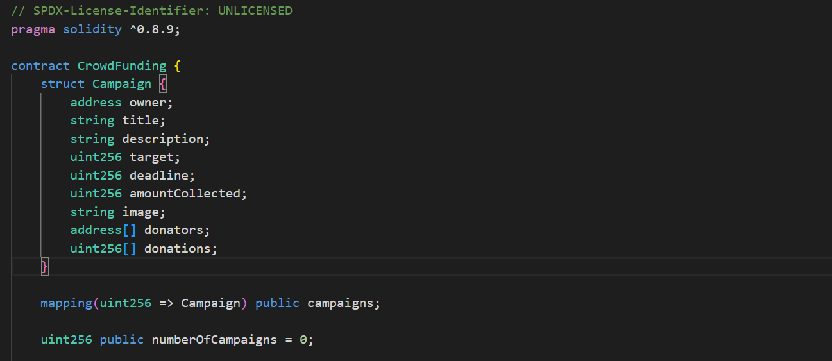
(iii) Crowdfund Smart Contract

Slide 11
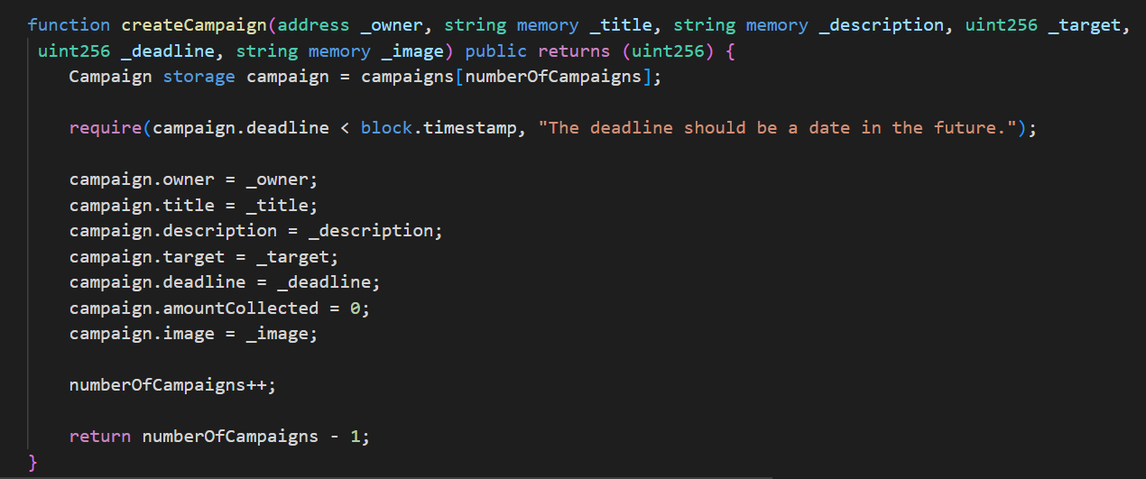

Slide 12
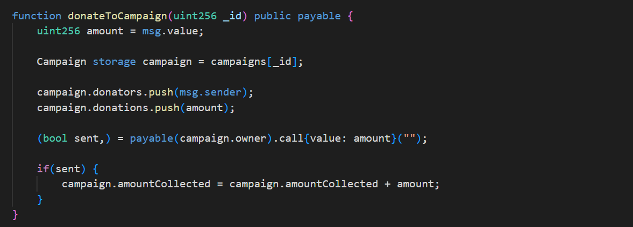

Slide 13
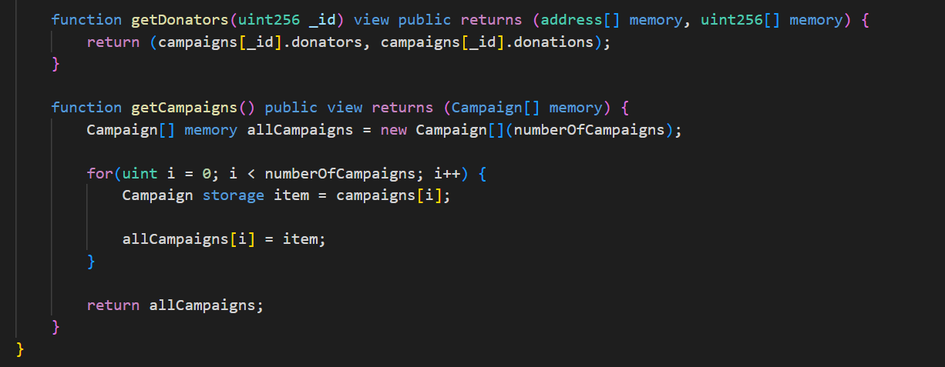

Slide 14
5.CONCLUSION:
Blockchain technology implemented crowdfunding can provide greater transparency and accountability to the system, which is currently lacking in traditional crowdfunding platforms
increase the chances of successfully raising funds for a cause
use of smart contracts and Ethereum blockchain technology can help automate and execute transactions securely, transparently, and efficiently
help prevent overfunding and ensure that the funds are used for their intended purpose.
integration of this feature with a social media platform can help promote crowdfunding campaigns and increase their visibility
we can conclude that in this research we proposes a solution to the existing issues in the crowdfunding system and offers a more secure, transparent, and accountable solution for users

Slide 15
6.References:
https://www.investopedia.com/terms/c/crowdfunding.as
R. Böhme, N. Christin, B. Edelman, and T. Moore, "Bitcoin: Economics, Technology, and Governance," Journal of Economic Perspectives, vol. 29, no. 2, pp. 213-238, 2015.
H. Alsmadi, A. Elchouemi, and A. Bendahhou, "Blockchain technology for crowdfunding: A decentralized approach," Journal of Theoretical and Applied Information Technology, vol. 97, no. 8, pp. 2094-2106, 2019.
T. Tran, N. Niyato, P. Wang, D. I. Kim, and D. N. Nguyen, "A Blockchain-Based Crowdfunding Framework for Sustainable and Socially Responsible Projects," IEEE Transactions on Engineering Management, vol. 66
Swan, M. (2021). Blockchain: Blueprint for a New Economy. O'Reilly Media, Inc.
Zhu, H., Zhou, Z.Z. “Analysis and outlook of applications of blockchain technology to equity crowdfunding in China,” Financ Innov, 2016
Gebert, Michael, “Application of blockchain technology in crowdfunding,” New European.

Slide 16
THANK YOU

